Slide 1
Big O Notation

Slide 2
Definition
A language and metric used to describe the efficiency of algorithms. How does time and space taken to run a program increase as the number of inputs increase.

Slide 3
Time Complexity
Shows how the runtime of a function increases as the size of input increases.
Algorithms perform differently based on conditions. Three case scenarios in measuring performance of any given algorithm
Best Case: The scenario where the algorithm performs the least amount of work, usually represented by the minimum number of operations needed.
Average Case: The expected scenario, which represents the average amount of work the algorithm does across all possible inputs.
Worst Case: The scenario where the algorithm performs the most work, typically represented by the maximum number of operations needed.

Slide 4
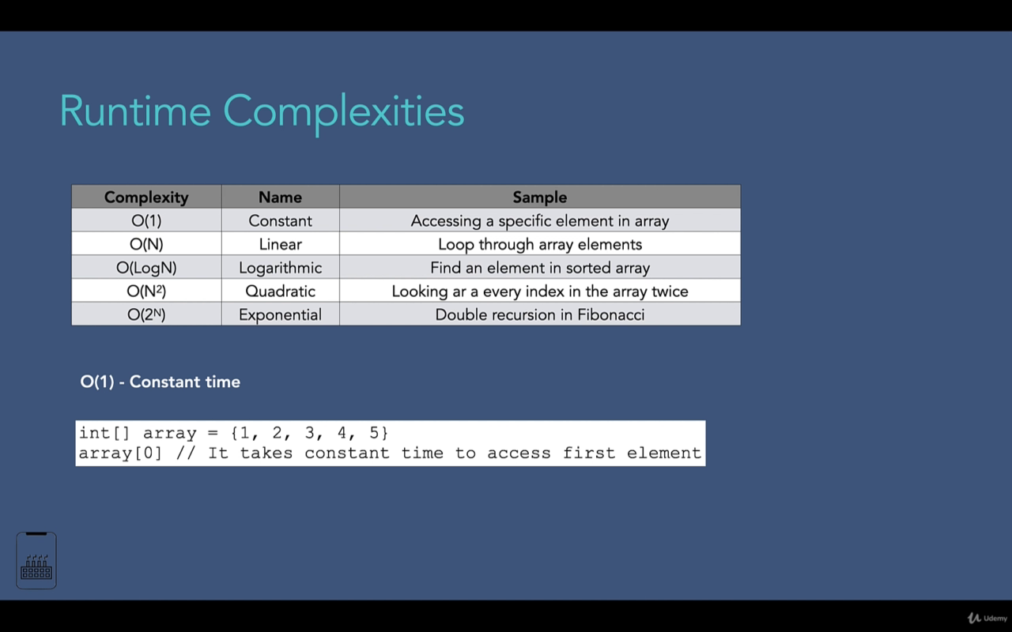
Runtime Complexities – O(1)

Slide 5
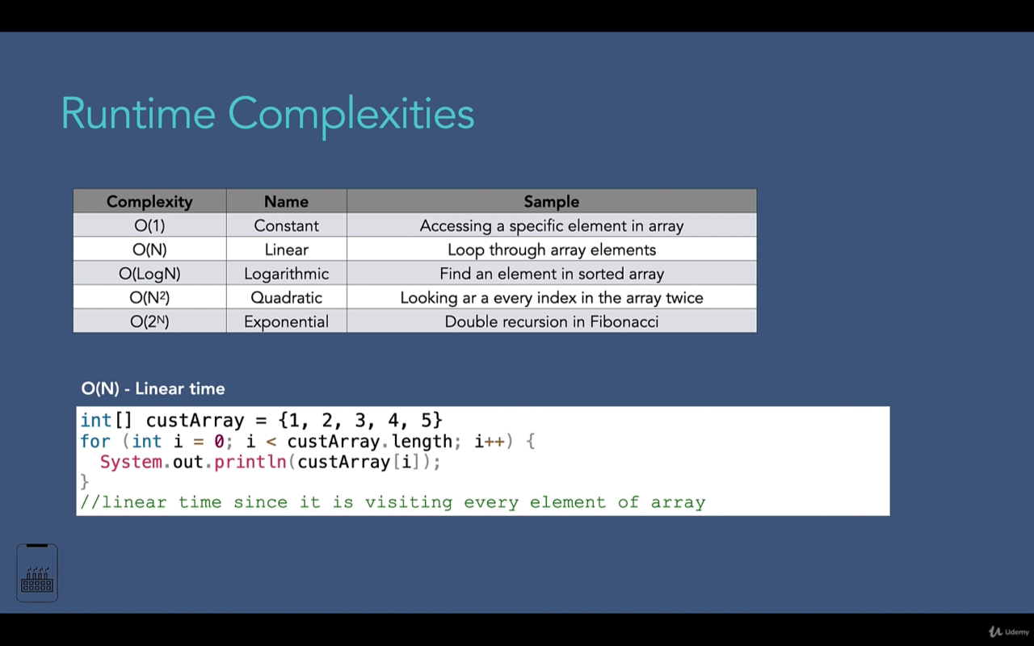
Runtime Complexities – O(n)

Slide 6
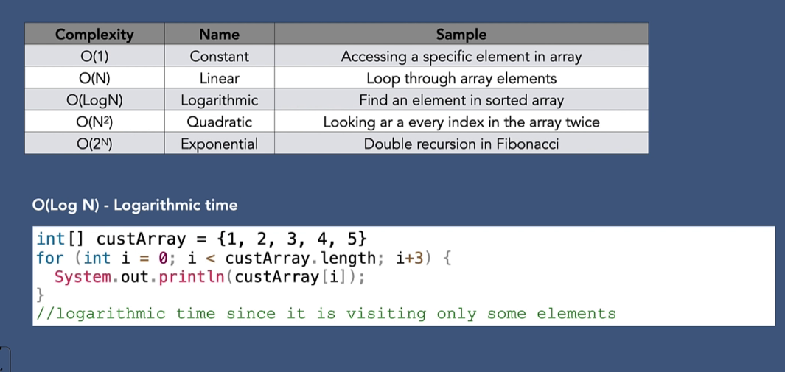
Runtime Complexities – O(Log N)

Slide 7
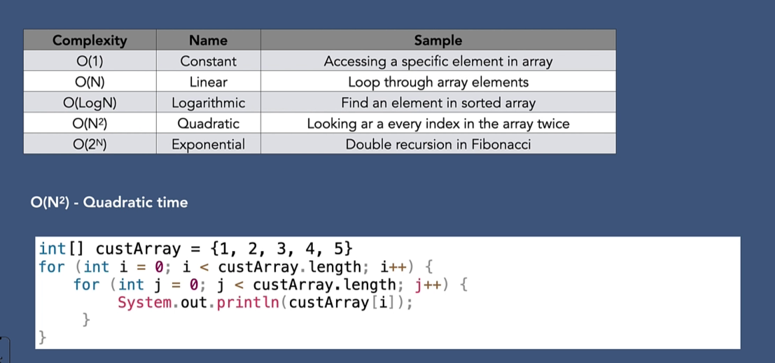
Runtime Complexities – O(n²)

Slide 8
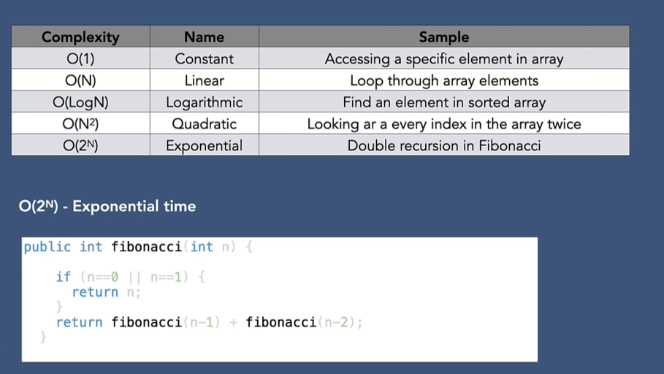
Runtime Complexities – O(2^{n})

Slide 9
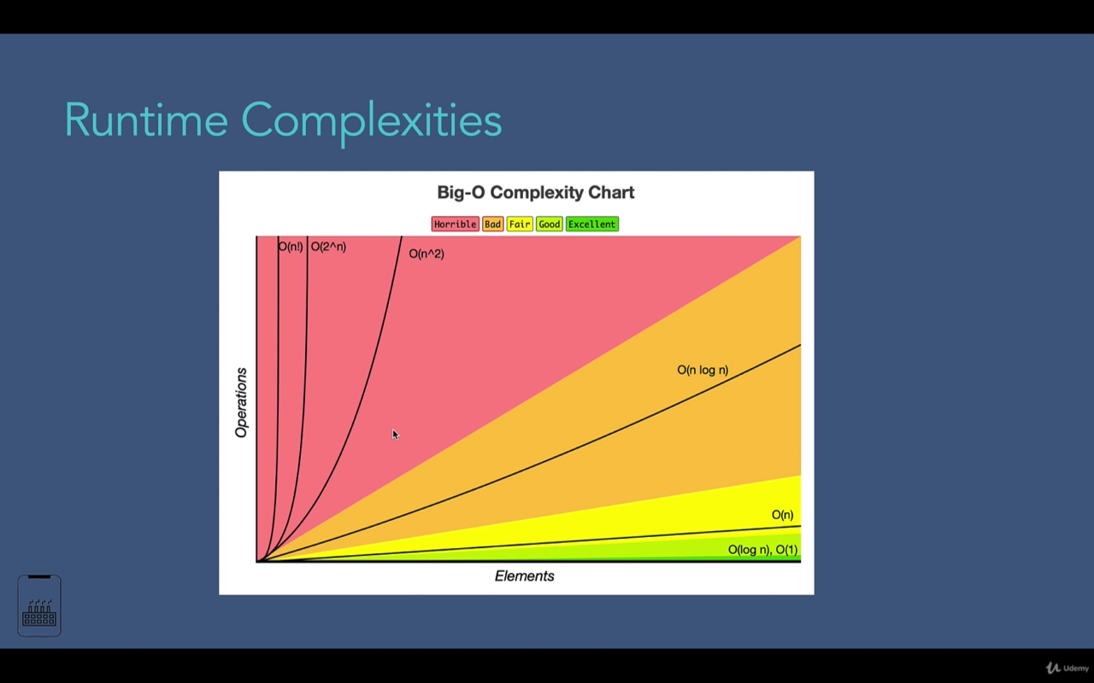
Summary

Slide 10
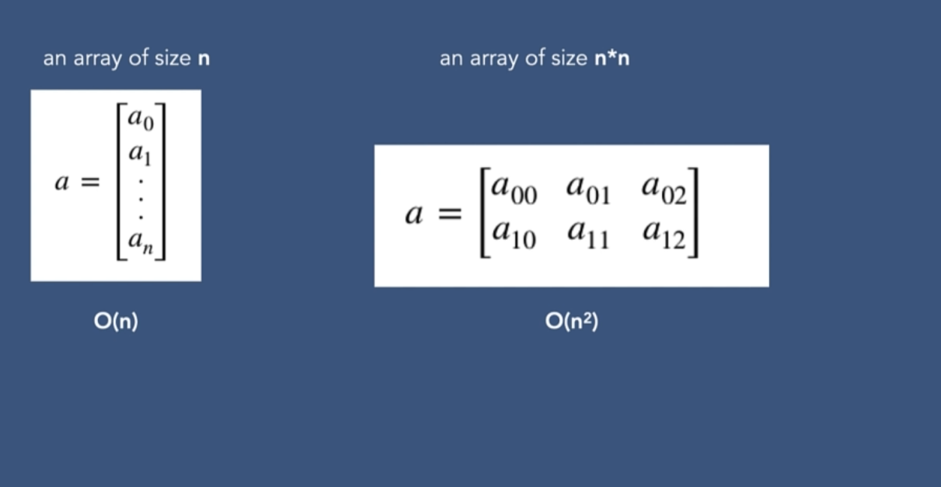
Space Complexity
Refers to the amount of memory an algorithm needs at worst case. How does space grows, as the number inputs grows?

Slide 11
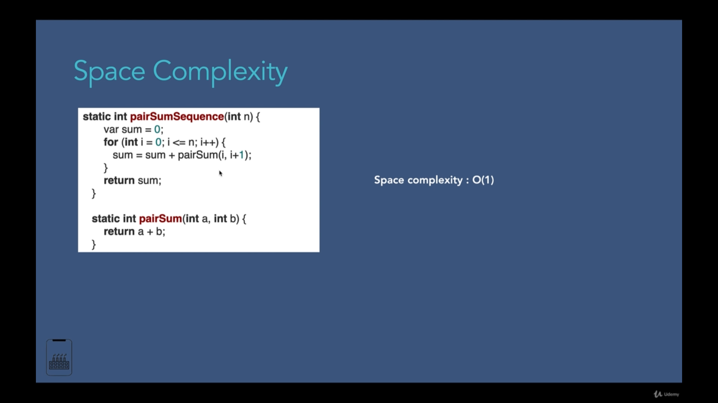

Slide 12
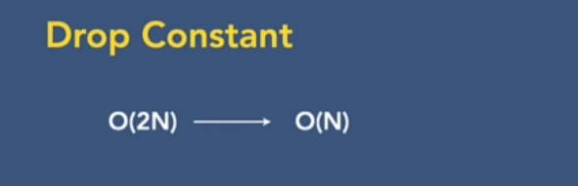
Drop Constant
Drop constant in big O notation: These constants mean external factors like computer capability, and we are only interested in algorithm only.
Constant is another factor, so it is simplified to only focus on input growth.

Slide 13
Drop Non Dominant Terms
The dominant term is the one that grows the fastest as n (the size of the input) becomes very large.
f(n)=3n³+5n²+2n+7
In the example above, 3n³ is the dominant term because it increases the quickest compared to the others when n is large.
2. Practical Example
Let’s consider the growth of each term for different values of n:
For n=1:
3+5+2+7=17
For n=10:
3000+500+20+7=3527
For n=100:
3000000+50000+200+7=3050207

Slide 14
Drop Non Dominant Terms Cont’d
As n increases from 1 to 100, the contribution of the n², n, and constant terms becomes much smaller compared to the contribution from the n³ term.
As the input size n increases, certain terms in a complexity function become insignificant compared to others. This is why we drop non-dominant terms; they do not affect the overall growth rate as n approaches infinity.
In other words, what term has the most significant impact on the function.

Slide 15
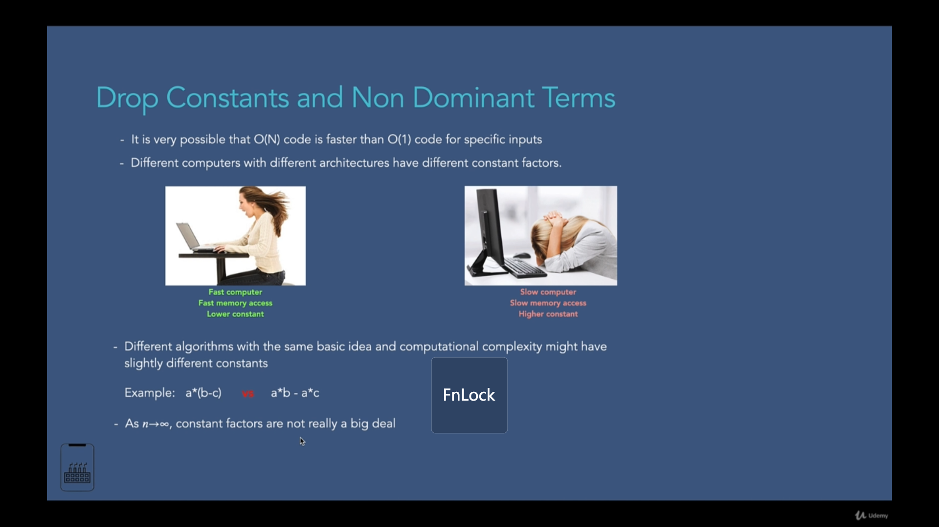
Why

Slide 16
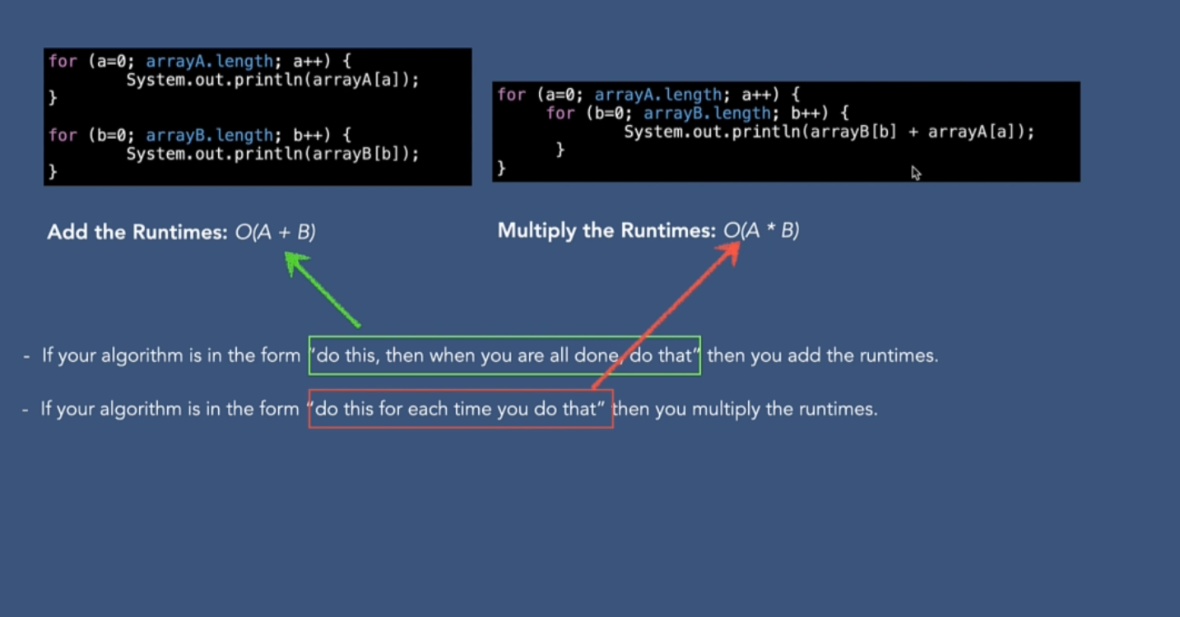
Addition & Multiplication

Slide 17
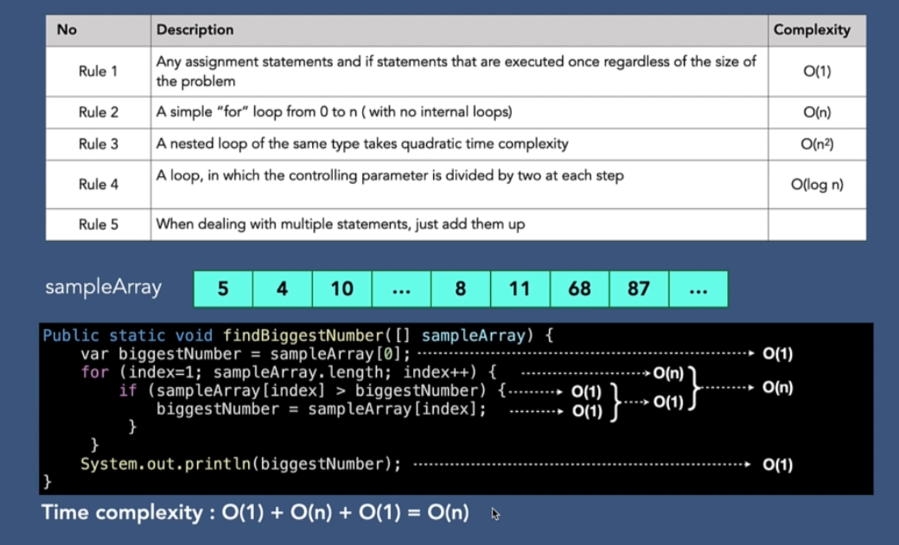
Rules of Measuring Big O of an Algorithm

Slide 18
Rules of Complexities
Combinations

Slide 19
Sequential Statements (Addition Rule)
Combined Complexity
O(n)+O(n^2)=O(n^2)
Rule: Only the term with the highest growth rate (largest Big-O) matters.

Slide 20
Nested Statements (Multiplication Rule)
Combined Complexity:
O(n)×O(n)= O(n^2)
O(n * n) = O(n^2)
O(n) * O(n^2) = O(n * n^2) = O(n^3)

Slide 21
Conditional (Maximum Rule)
Choose the complexity of the branch with the highest order.
If(){ O(1) } else{ O(n) }
Is O(n)

Slide 22
Recursive Calls
2^n

